Slide 1
Wearable Embedded System for Health Monitoring
Student: Rui Wang
Supervisor: Qing Liu

Slide 2
CONTENT
1. Introduction
2. Project Objective
3. Methodology
4. Experimental Results
5. Discussion
6. Future Works
7. Conclusion
1

Slide 3
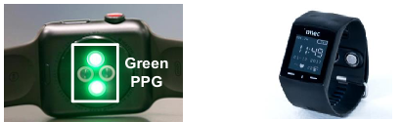
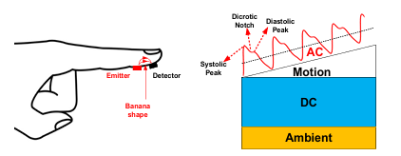
Introduction
Wearable devices market is currently having a constant growing rate and this year it is estimated to reach a value of approximately $130 billions [1].
Photoplethysmography (PPG) is widely used in wearable health devices, because it can
Achieve non-invasive and continuous monitoring
Effectively monitor heat rate (HR) and blood oxygen saturation (SPO2)
Be integrated into chip and consume lower power
PPG sensor usually has two type, reflective and transmissive model. It comprises LEDs and photodetectors. The common LEDs includes: Infrared Red, Red, Green and Yellow. The wear positions are finger tips, wrist or earlobe.
[1] Duarte Dias & João Paulo Silva Cunha, published in MDPI Sensors, 2018
[2] Qiuyang Liu et al. published in IEEE CICC, 2022
[2]
2

Slide 4
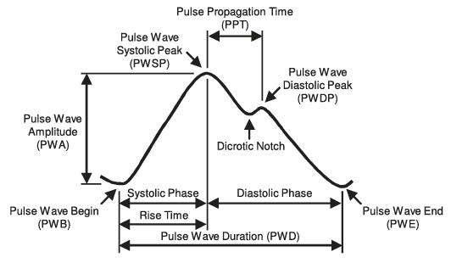
Introduction
PPG Signal
Systolic Phase: blood is ejected into arteries from heart
Diastolic Phase: blood fluxes into heart from arteries
Dicrotic Notch: closure of aortic valve, a slight increasement in blood pressure
Challenges
Motion Artifacts
Ambient light interference
Baseline Drift
[3]
[3] Christoph Fischer et al. published in IEEE JOURNAL OF BIOMEDICAL AND HEALTH INFORMATICS, 2017
3
Notes:
Motion Artifacts: PPG signals are sensitive to motion artifacts caused by the movement of the subject. Body motion can introduce noise and distortions into the PPG waveform, making it challenging to obtain accurate physiological information.
Ambient Light Interference: Ambient light can interfere with PPG measurements, especially when using reflective PPG sensors. This interference can lead to inaccurate readings and affect the reliability of derived parameters.
Baseline Drift: The baseline of the PPG signal may experience slow drifts over time, known as baseline wandering. This can be caused by changes in skin perfusion or other environmental factors.

Slide 5
Project Objective
Improve Signal Quality
Remove baseline shifting and noise
Precisely annotate peaks and valleys
Identify and eliminate artifacts
Finally improve calculated physiological metrics
Deploy on Device
Fast and accurate computation at MCU
Low power consumption and less storage
Compatible sampling rate and transmission rate
Convenient transmission approach
4

Slide 6
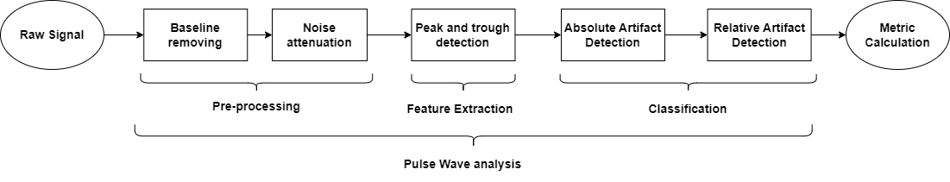
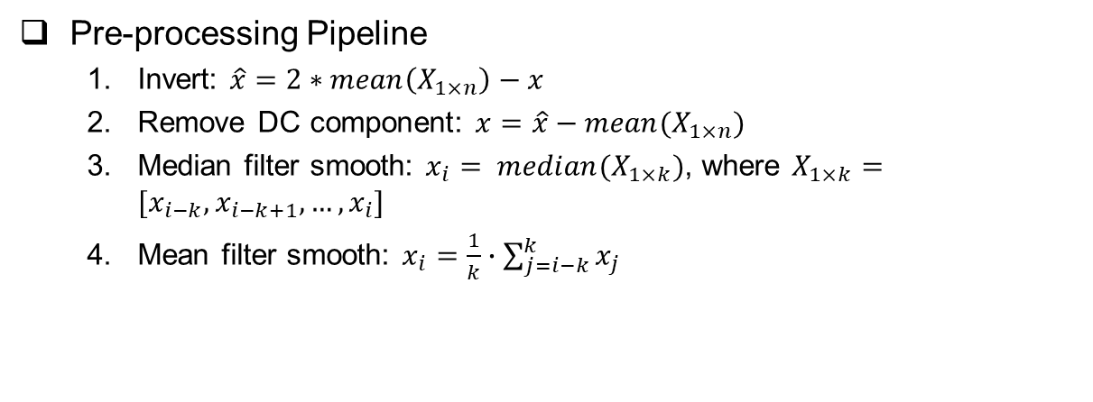
Methodology
Pre-processing Pipeline
Invert: $\hat{x}=2∗mean\left(X_{1×n}\right)−x$
Remove DC component: $x=\hat{x}−mean(X_{1×n})$
Median filter smooth: $x_{i}= median(X_{1×k})$, where $X_{1×k}=[x_{i−k}, x_{i−k+1},…,x_{i}]$
Mean filter smooth: $x_{i}=\frac{1}{k}∙\sum_{j=i−k}^{k}{x_{j}}$
5

Slide 7

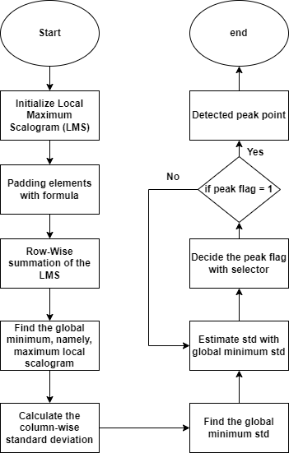
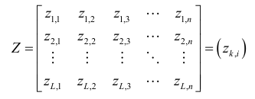
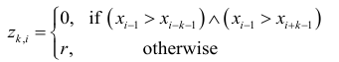
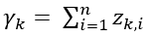

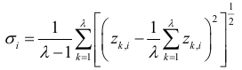

Methodology
Automatic multiscale-based peak detection [4], [5]
[4] Felix Scholkmann et al. published in Algoritms, 2012
[5] Alperen Mustafa Colak et al. published in Circuit and Systems, 2018
6

Slide 8
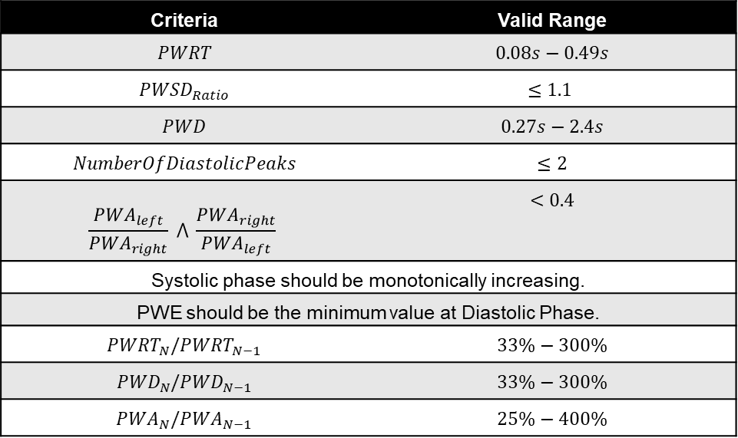
Methodology
Artifact Detection Criteria [3]
Criteria | Valid Range
$$PWRT$$ | $$0.08s−0.49s$$
$${PWSD}_{Ratio}$$ | $$≤1.1$$
$$PWD$$ | $$0.27s−2.4s$$
$$NumberOfDiastolicPeaks$$ | $$≤2$$
$$\frac{{PWA}_{left}}{{PWA}_{right}} ⋀ \frac{{PWA}_{right}}{{PWA}_{left}}$$ | $$<0.4$$
Systolic phase should be monotonically increasing.
PWE should be the minimum value at Diastolic Phase.
$${PWRT}_{N}/{PWRT}_{N−1}$$ | $$33\%−300\%$$
$${PWD}_{N}/{PWD}_{N−1}$$ | $$33\%−300\%$$
$${PWA}_{N}/{PWA}_{N−1}$$ | $$25\%−400\%$$
Absolute
Relative
[3] Christoph Fischer et al. published in IEEE JOURNAL OF BIOMEDICAL AND HEALTH INFORMATICS, 2017
7

Slide 9
Experiment Result
Slope & Threshold
Threshold is 0.75 heart interval
Peck and valley at local regions
False local regions
AMPD
No needed threshold
Detect within high noise
Missed peaks
8

Slide 10
Experiment Result
Noise Artifact
Skewness
Single Pulse Waveform
Nonmonotonic increasing
Motion Artifact
Distortion
Successive Pulse Waveforms
Invalid relative PWAs and PWRTs
Detected Noise Artifact
Detected Motion Artifact
9

Slide 11
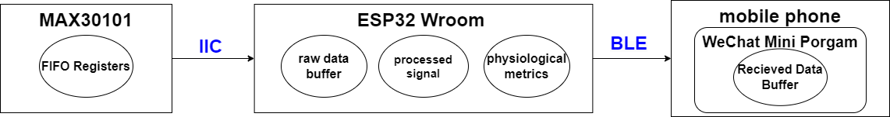
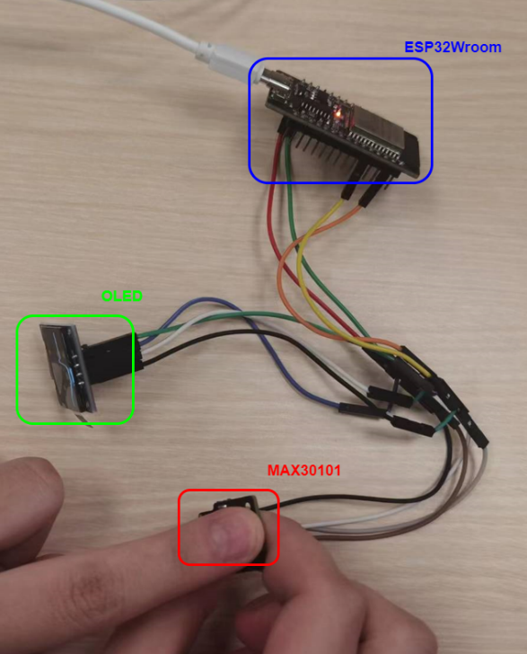

Experiment Result
Demo
Physical map
Demo URL: https://github.com/1102131860/FYP
10

Slide 12
Discussion
AMPD is generally better than Slope & Threshold Method
Almost no hyper-tuning parameters needed
Highly anti-noisy
Make the size of filter window much smaller
The noise artifact tends to lead the skewness of single pulse waveform and thus it can be detected by the nonmonotonic increasement at systolic phase. The motion artifact is more likely to make several consecutive pulse waveform distorted and thus detected by relative criteria.
Transmission packet size is affected by transmission rate. Therefore, it also impacts the sampling rate and buffer size at MCU
11

Slide 13
Future Works
Data visualization
Line graph or bar graph
Cloud Server
Data stored in cloud and cloud/edge computing
12

Slide 14
Conclusion
Improve signal quality by implementing AMPD to segmentize signal waveform and eliminating artifacts after identifying them through absolute and relative criteria.
Deployed those algorithms at MCU and utilize BLE to achieve wireless data transmission between MCU and WeChat Mini program
13

Slide 15
Thank You
Question?

